Slide 1

Қазақ Елі
Ruslan Akzholbek
Leskhan Karataev

Slide 2
Description
“Қазақ елі” is a mobile application by which you will get your knowledge level in History of Kazakh Khanate and Kazakh national tradition.

Slide 3
Problem
In today`s life, most of our teenagers do not have even simple meanings about our traditions and history. We are imitating to West countries, so that day by day we are forgetting our culture.

Slide 4
Solution
Our questionnaire application can help to solve these problems, because:
Simple but important questions
Modernized
Easy to use
Only reliable information
Spectacular

Slide 5
Mockup screens

Slide 6
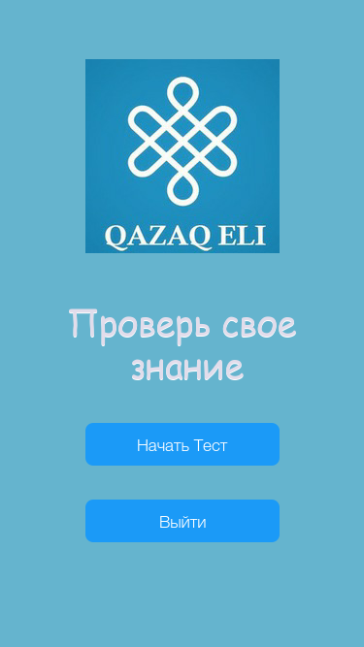
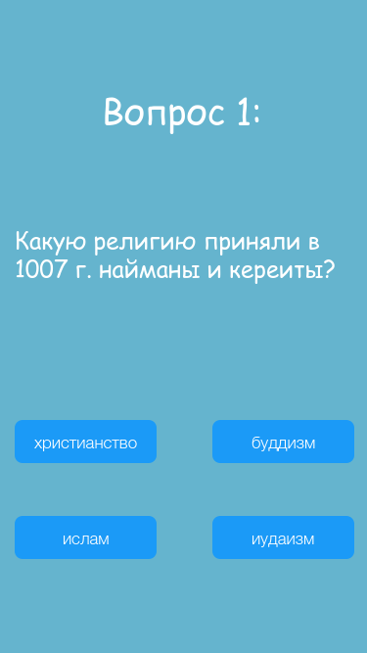
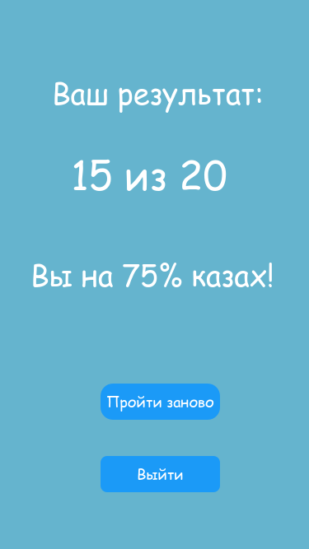

Slide 7
Onboarding Screens

Slide 8




Slide 9
Why is better?
As we checked from AppStore, we couldn`t find such kind of applications. So our app will be the first in such direction.
Our app will be easy to use, so people will be interested on it.
We used questionnaire method, because it`s most useful way to remember information.

Slide 10
Market Size
Our target audience will be every people who interested in developing their knowledge in history and traditions of Kazakhstan.

Slide 11
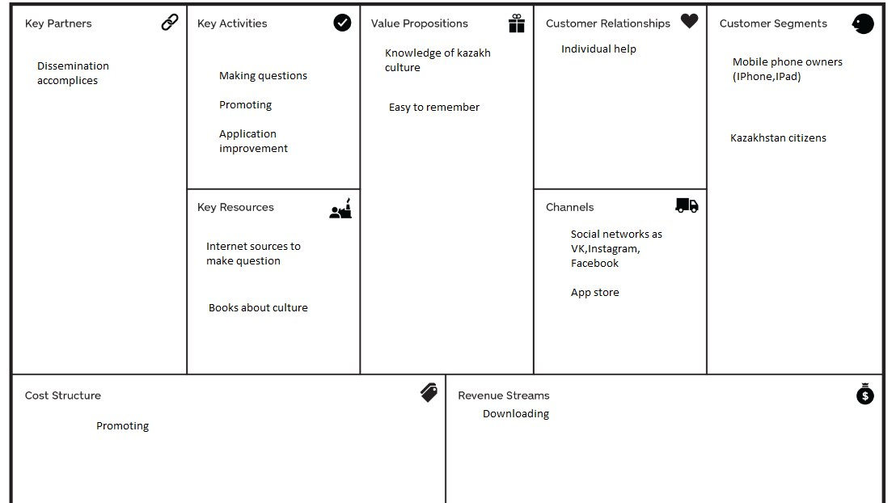
Business model

Slide 12
Marketing Plan
First of all we should check if our app is working without any mistakes. If everything is ok, we will ask from our friends from YuFrame to advertise our application in short video.
Why Yuframe? Because they have more than two million audience, that are interested in their vines. I think this will be a good way and reliable way.

